Slide 1
Mail System
Mid-Term Presentation
22nd January 2025
Date

Slide 2

Supervised By
Dr.Kazi Muheymin-Us-Sakib
Professor
Institute of Information Technology
Presented By
Md.Nafish Salehin
Roll. bsse1527

Slide 3
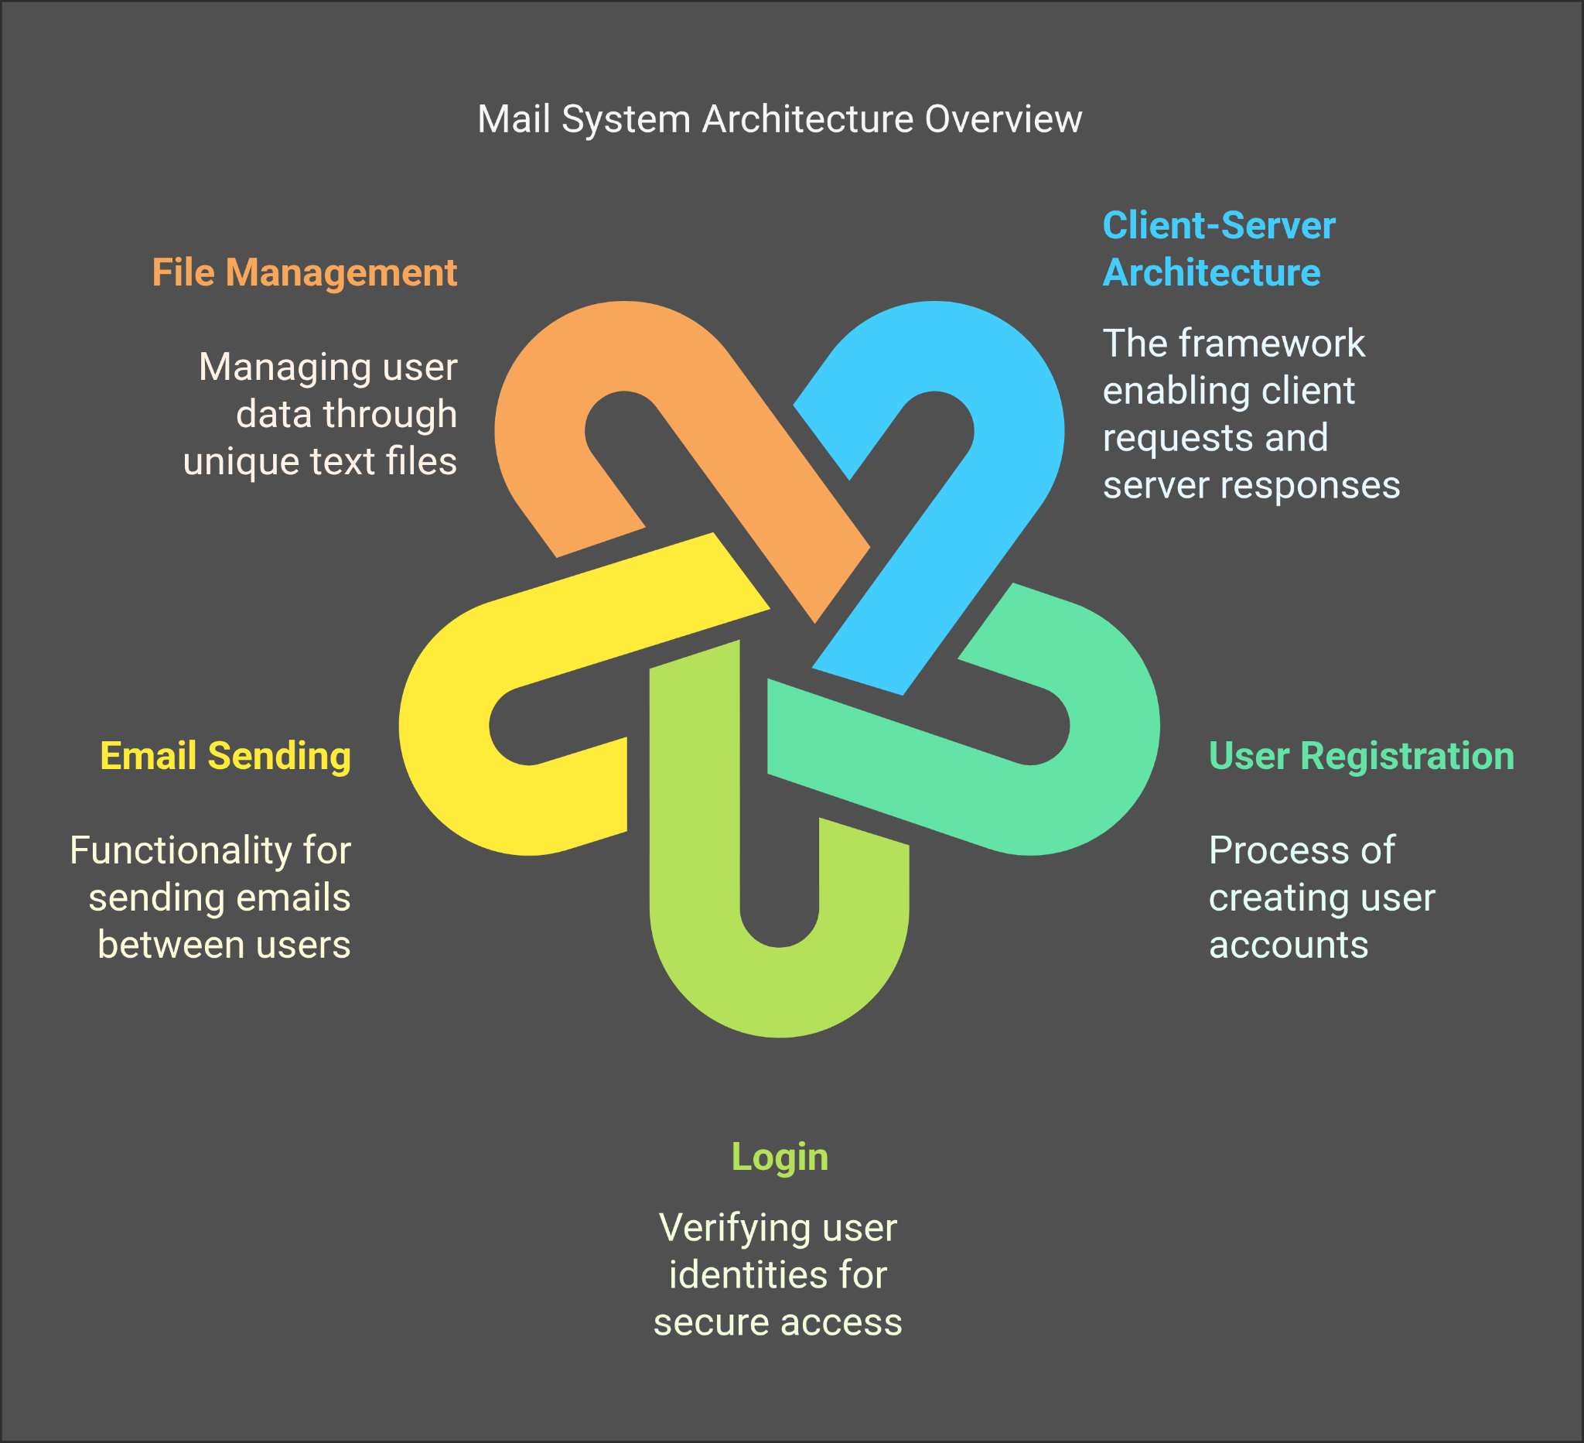
What ?
Communication

Slide 4
WHY ?
Enhanced Collaboration
An easy communication system allows for seamless collaboration among team members. With a mail system, individuals can quickly share ideas, documents, and feedback, leading to more efficient teamwork. This collaborative environment encourages creativity and innovation, as team members can easily bounce ideas off one another.
Increased Productivity
When communication is straightforward and accessible, productivity tends to increase. A mail system can reduce the time spent on back-and-forth messages, allowing users to focus on their tasks. Quick access to information and the ability to communicate instantly can help individuals meet deadlines and achieve their goals more effectively.
Improved Relationships
Effective communication is the foundation of strong relationships. A mail system that facilitates easy communication can help build trust and rapport among users. By allowing individuals to express their thoughts and concerns openly, misunderstandings can be minimized, leading to healthier interactions both personally and professionally.

Slide 5
Accessibility and Convenience
An easy communication system enhances accessibility, allowing users to communicate from anywhere at any time. This convenience is particularly beneficial in today’s remote work environment, where team members may be spread across different locations. A mail system can bridge the gap, ensuring that communication remains fluid regardless of physical distance.
Social Life
A mail server facilitates instant communication, enabling people to stay connected, collaborate, and share information efficiently. It enhances social interactions by supporting both personal and professional conversations. As a result, it strengthens relationships and fosters a sense of community.

Slide 6
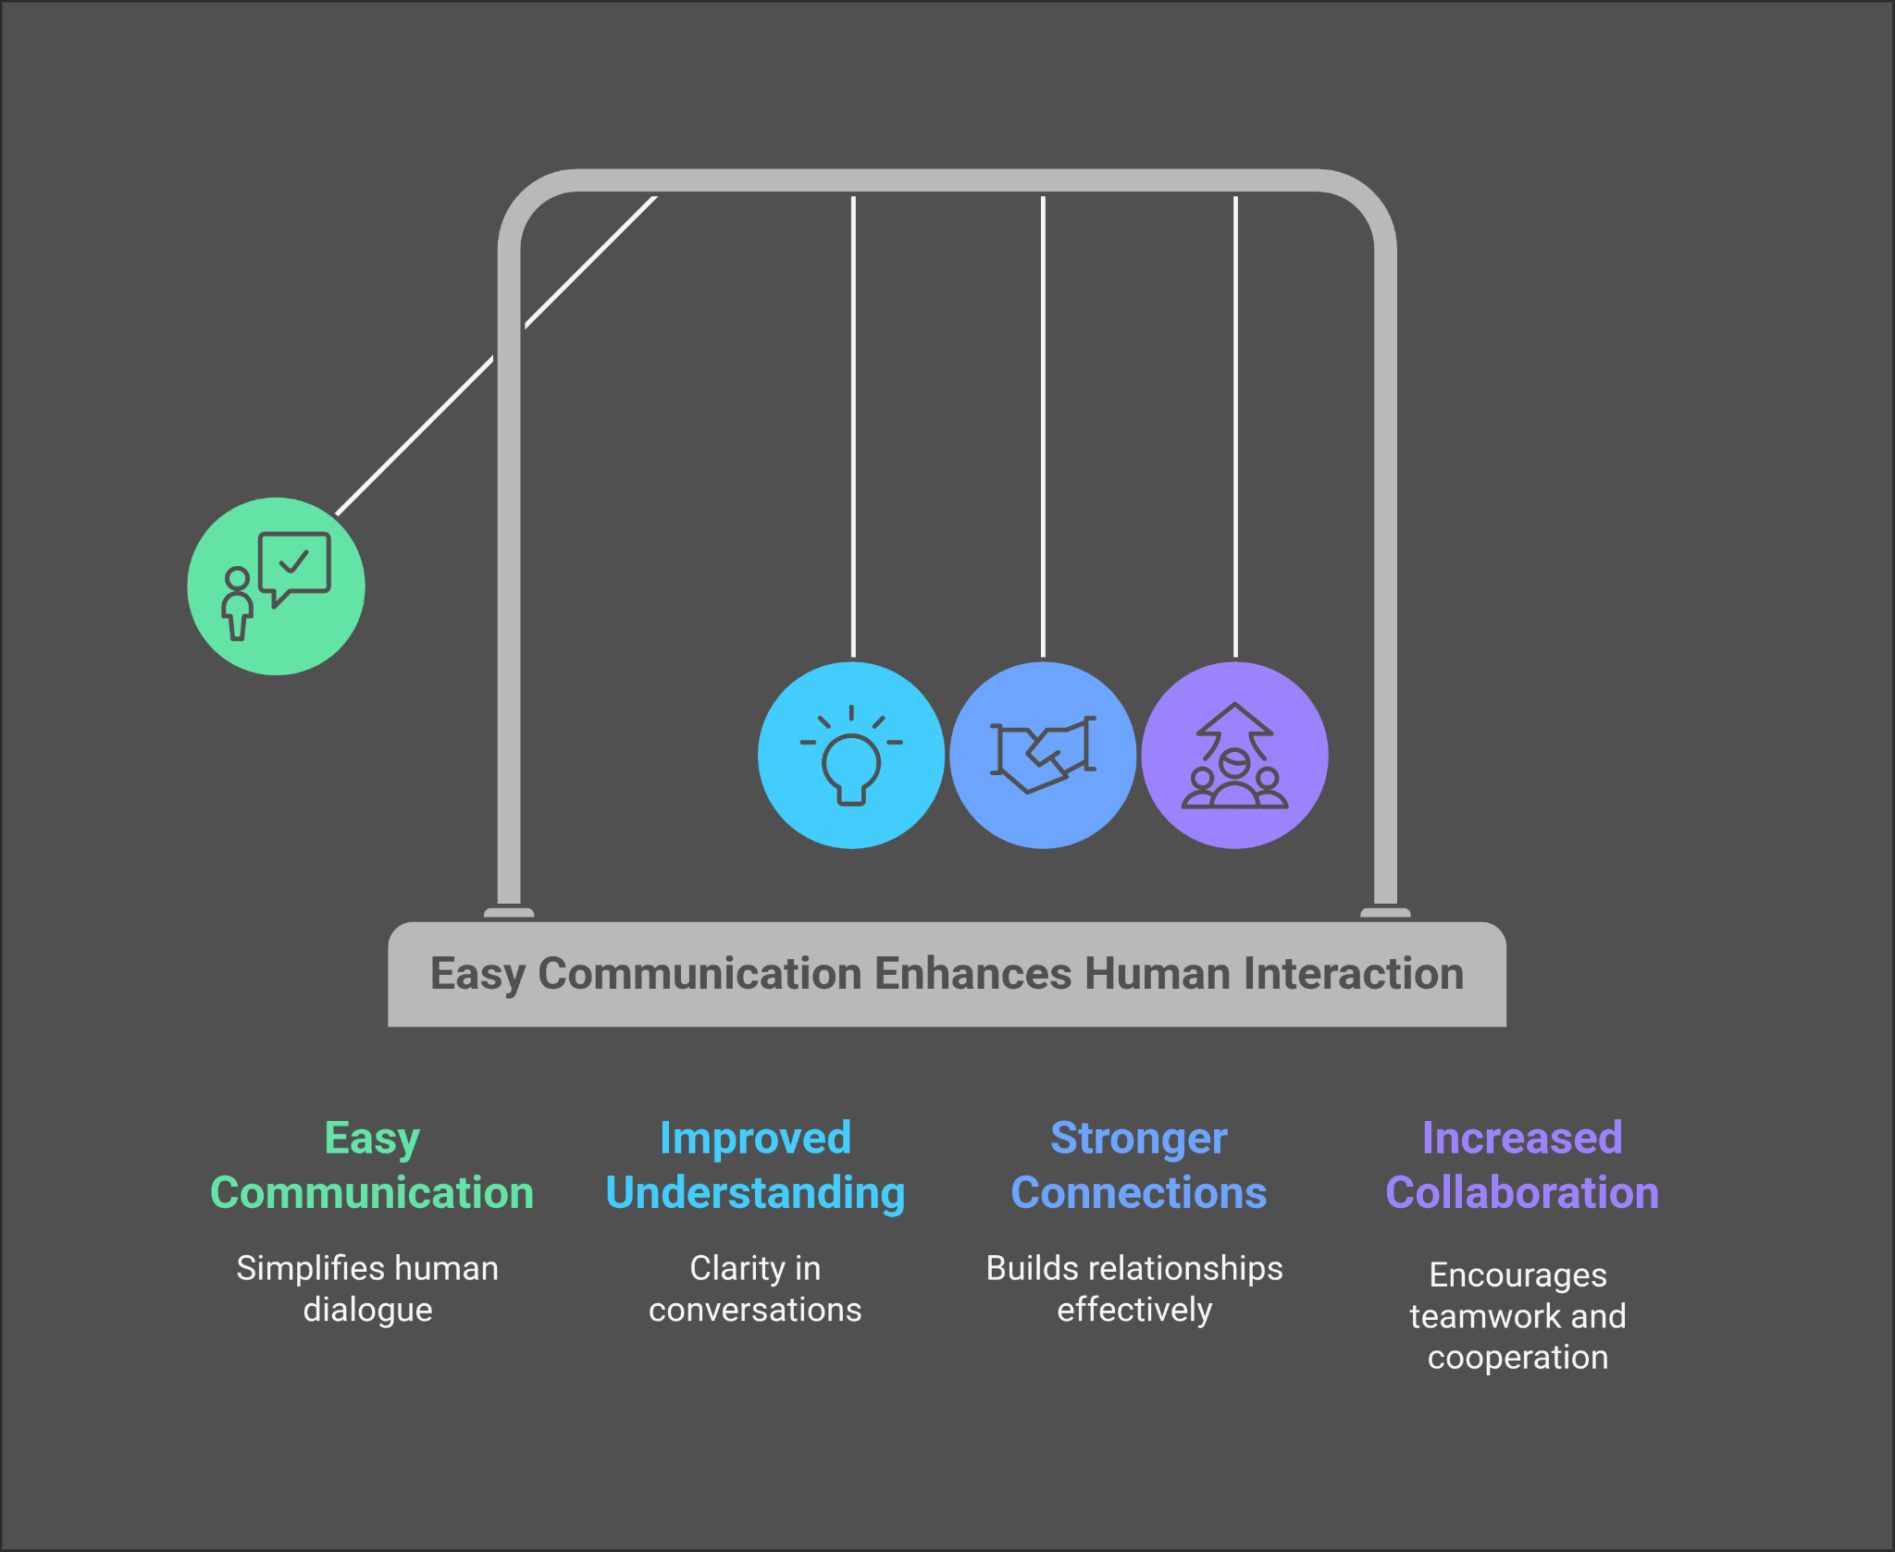
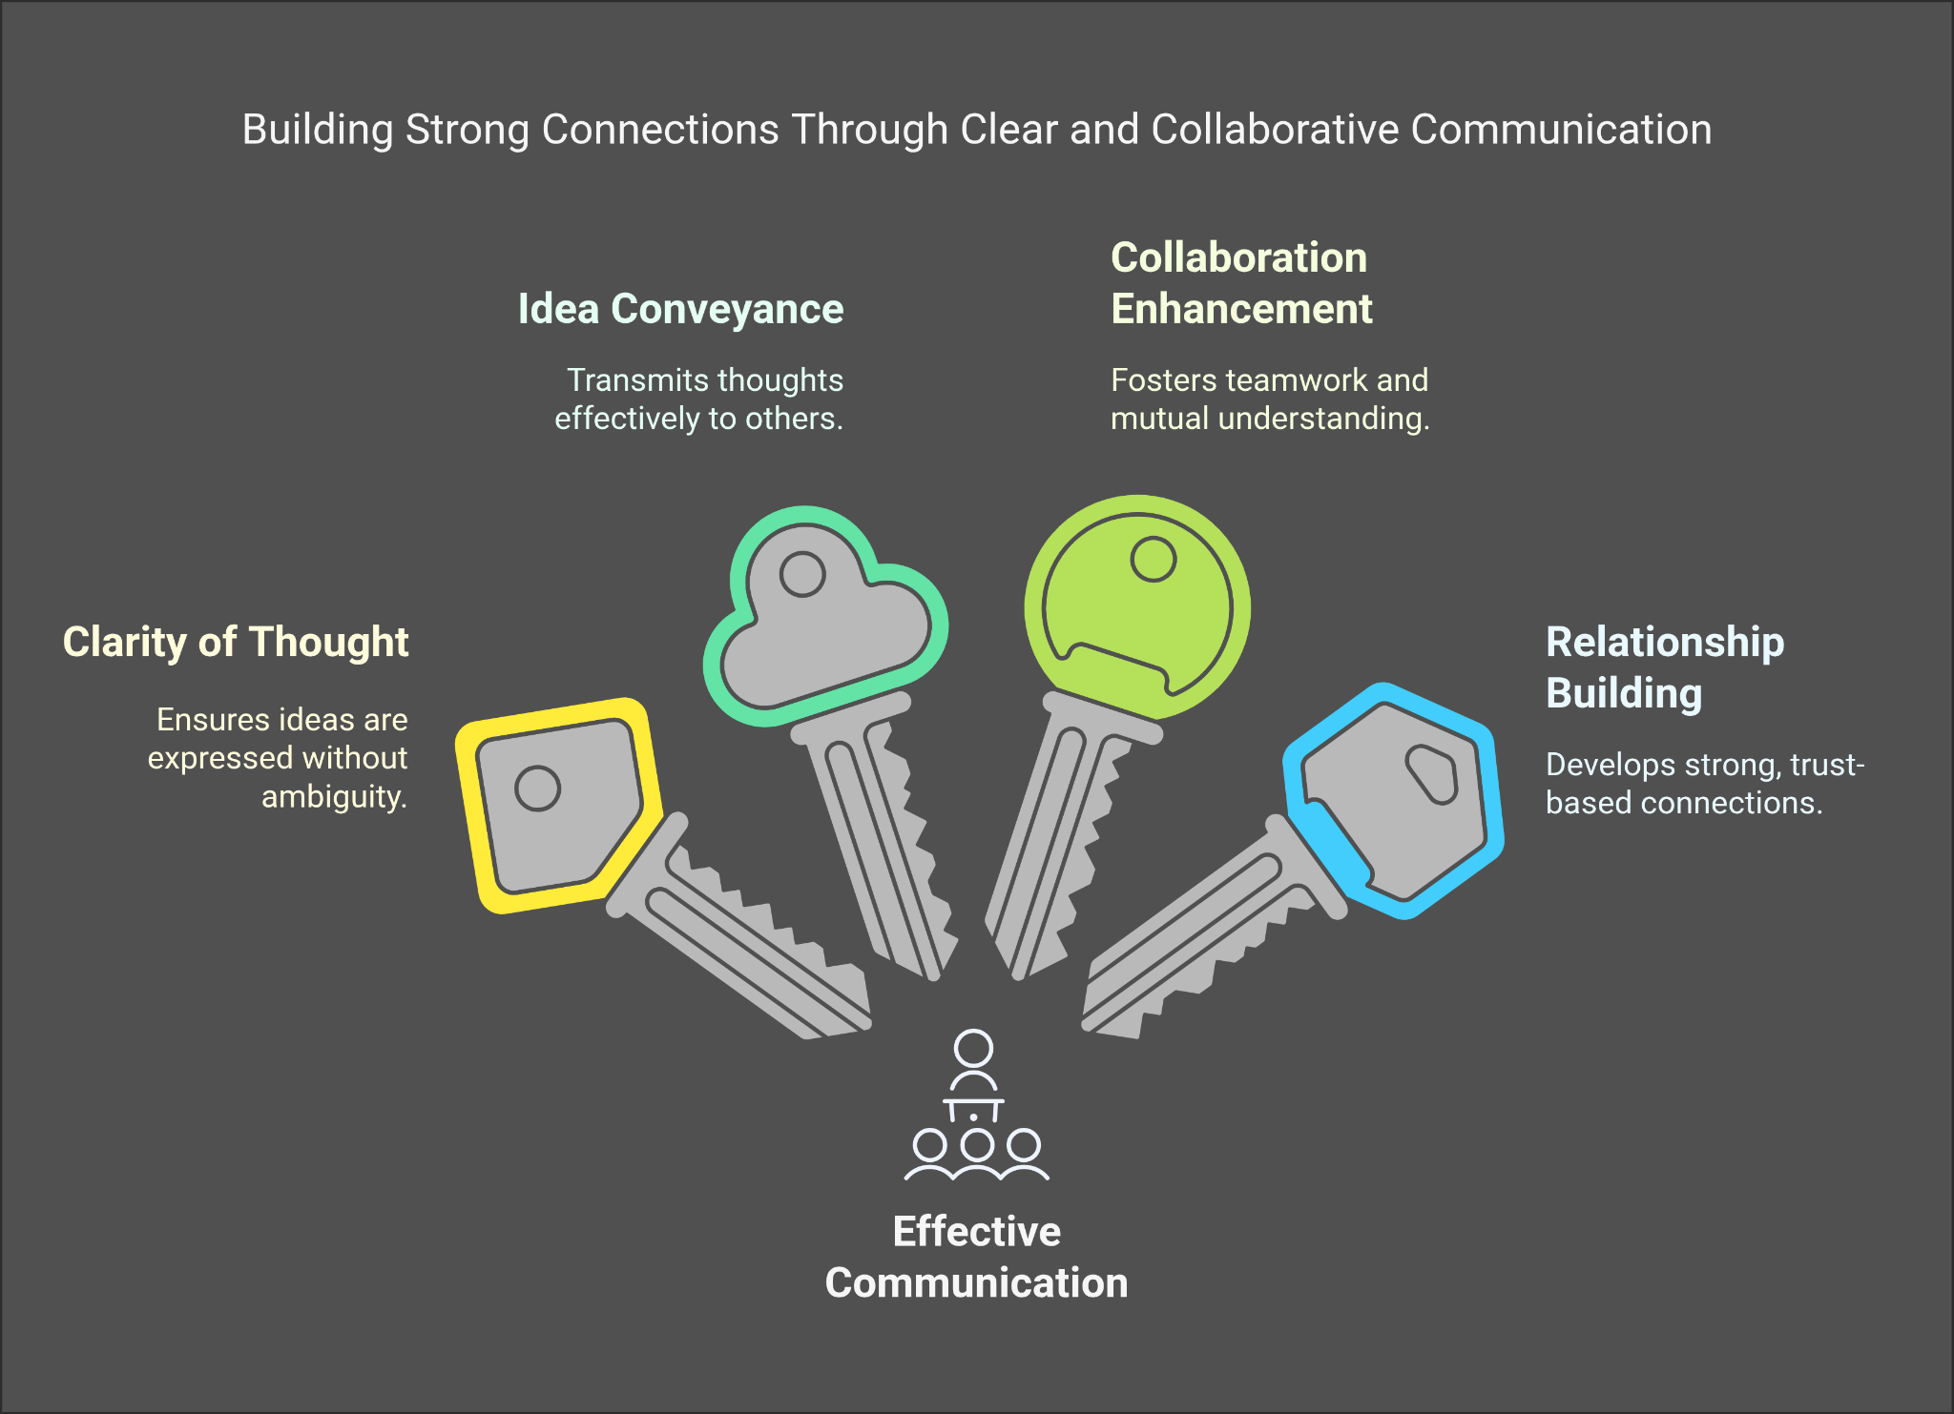
Communication is important for social, academic, and professional life, and it should be easier.
It can make our life easier

Slide 7
HOW ?
Server and client can communicate under a local network.
If the server is running, then a client can request registration.
A registered client can login using his password and username.
After logging in, a client sends mail to another client, and he/she can access his/her own recipient mailbox.
The server creates a different file for each client after his/her registration
The server stores each client username and password in a key value (map) for further record.

Slide 8




TOOLS
C++ Programming Language
Berkeley socketing
TCP protocol
Google Slides
Napkin
Git Github

Slide 9
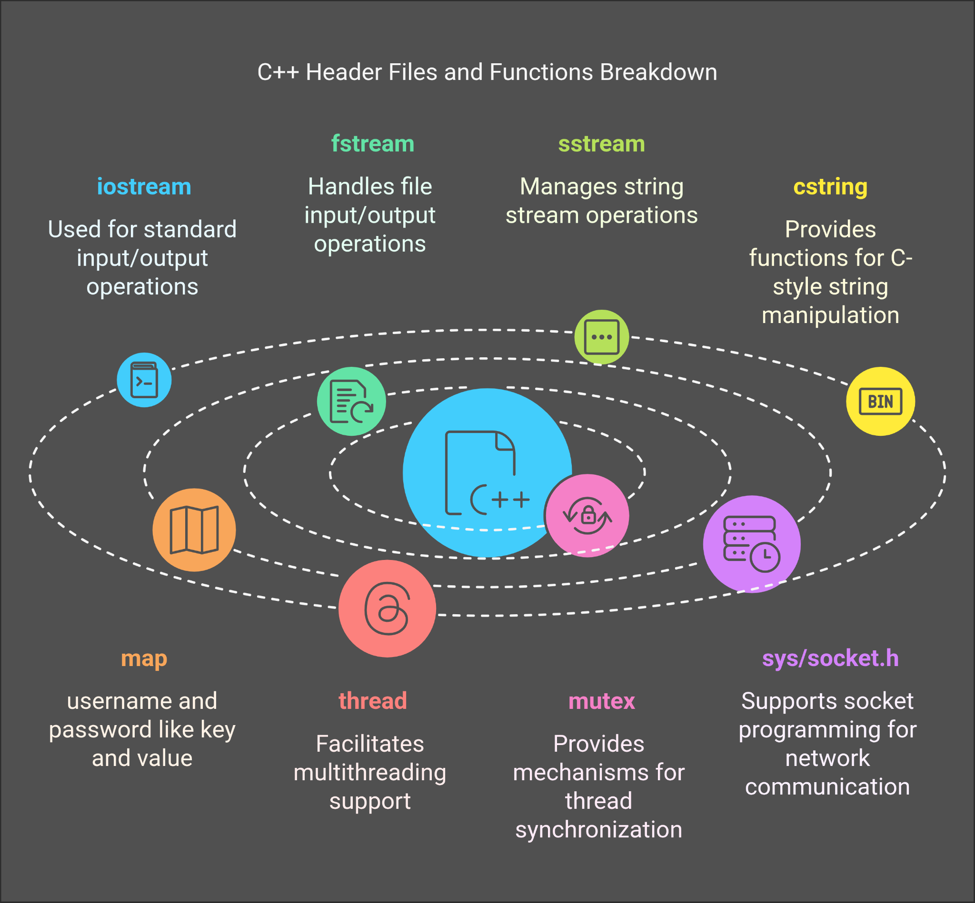
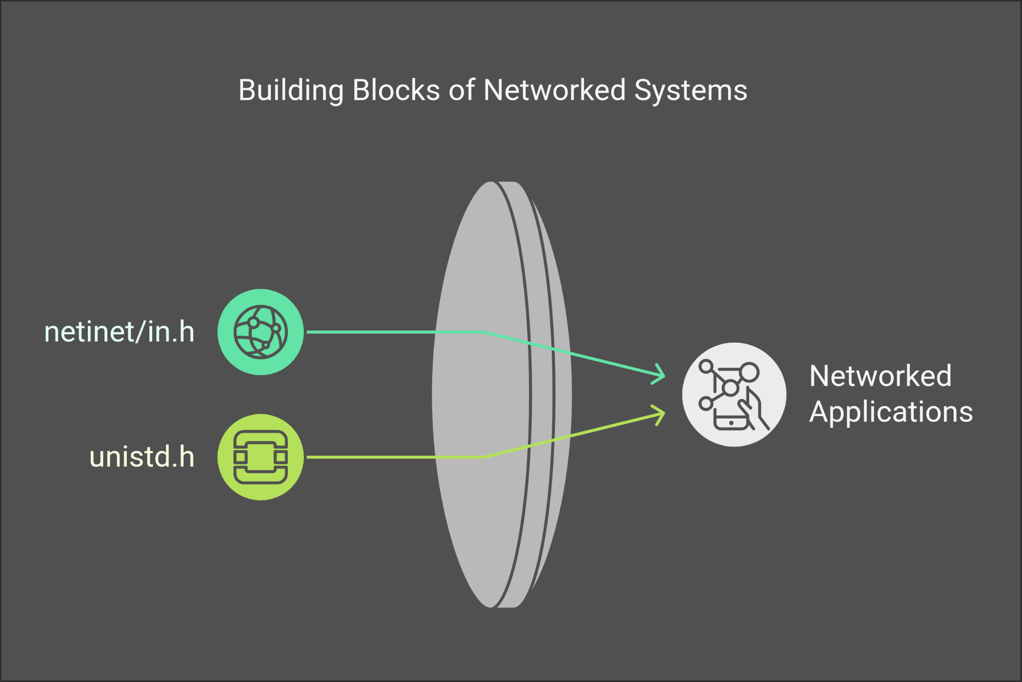
Used Headfile and purpose

Slide 10
Registration and login
User Registration:
Client request to register.
If the username is unique, the user is added to the users map and saved to the file
If the username is already used then registration will not be completed.
In a proper registration i will store his username and password in users.txt file for next time login.
I will store (username: password) in this format.
User Login:
Credentials are verified against the users map.
If the password and username matched properly then a user can access for sendmail,viewmail.

Slide 11
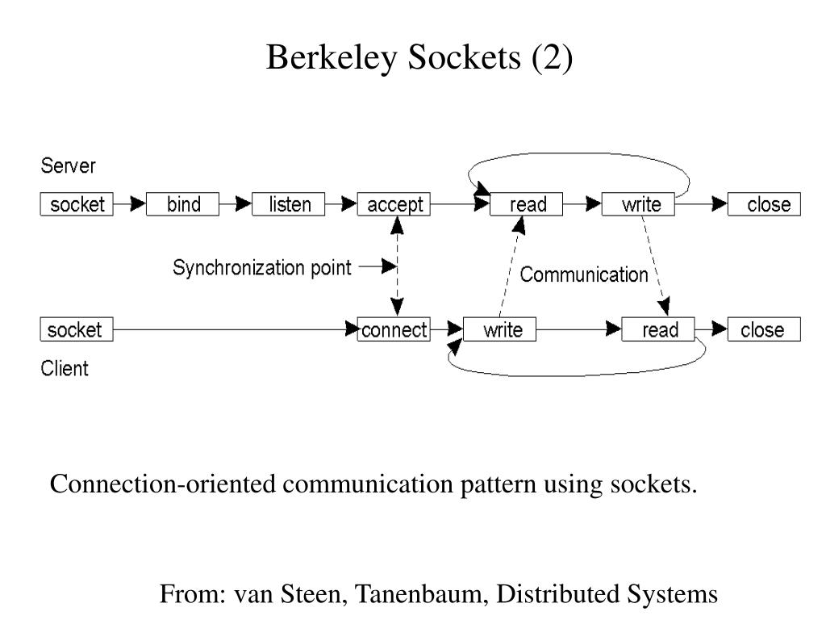
Registration and login
Firstly, the server ran. Then a client can request registration. This communication was established via socketing.

Slide 12
Send Mail and View Mail
For each client i make different file using his/her username.
If a client is logged in then he can access to open his own mailbox.
I just store only the receipt mail as a text.
User also can see who send the mail.
If a registered user want to send mail to another user then he can.
If the recipient isn’t registered then i will send error message to the client.

Slide 13
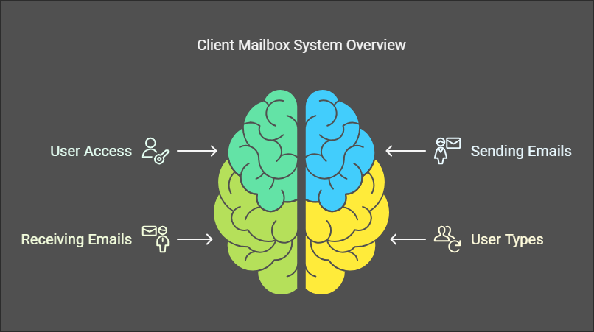

Slide 14
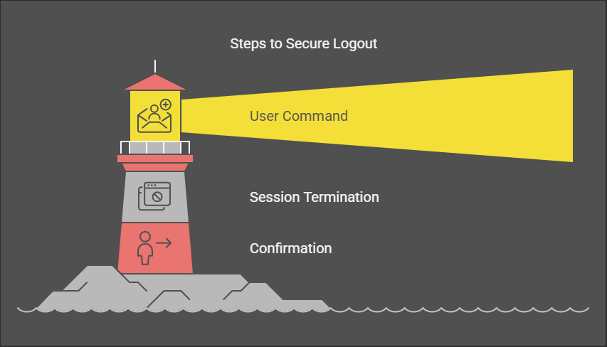
Logout Process
User Command: The user can initiate a logout process through a designated logout button or link within the mail client interface.
Session Termination: Upon logout, the server invalidates the user's session token or cookie, effectively ending the session.
Confirmation: The user may receive a confirmation message indicating that they have successfully logged out.

Slide 15
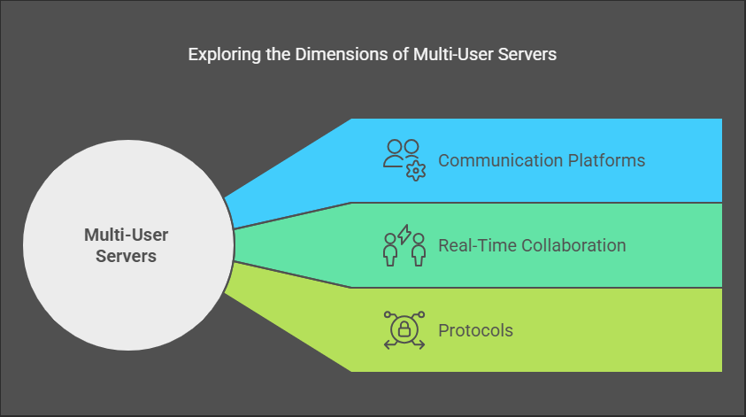
Multithreading
One server can handle multiple user at a same time without any conflict.
It can use for real time communication and for team work.

Slide 16
Future Plan
There are several problem in my code.
It’s not proper user friendly.
Group mail system i want to implement.
The user’s details i can store in cloud
Forward system can be done
I store the user’s data in random order it can be stored in sorted order.

Slide 17


